Slide 1
Historic Year 2019-2023 and Forecast to 2032
Global Fuel Cards Market
Card Type: Branded Fuel Cards (Closed-Loop), Universal Fuel Cards (Open-Loop), Merchant Fuel Cards, Hybrid cards Vehicle Type: Heavy Fleet, Medium Fleet, Light Fleet Technology: Smart Cards, Standard Cards Fleet Operator: Truck Fleet Operators, Business Fleets, Construction Fleets, Others Subscription Type: Basic Subscription, Premium Subscription, Fleet Subscription, Individual Subscription, Corporate Subscription, Business Subscription, Enterprise Subscription, Others Fuel Type: Diesel, Petrol / Gasoline, Others Application: Fuel Refill, Parking, Vehicle Service, Toll Charge, Others Sales Channel: Direct Sale, Online Sales, Third-Party Distributors By Region: North America, Europe, Asia-Pacific, Latin America, Middle East & Africa

Slide 2
MARKET SEGMENTATION
Global Fuel Cards Market(USD MILLION)
YEARS CONSIDERED :
Historical year - 2019-2023 | Base year - 2024 | Forecast year - 2025-2032
BY CARD TYPE
BY VEHICLE TYPE
BY TECHNOLOGY
BY FLEET OPERATOR
BY SUBSCRIPTION TYPE
Branded Fuel Cards (Closed-Loop)
Universal Fuel Cards (Open-Loop)
Merchant Fuel Cards
Hybrid cards
Heavy Fleet
Medium Fleet
Light Fleet
Smart Cards
Standard Cards
Truck Fleet Operators
Business Fleets
Construction Fleets
Others
Basic Subscription
Premium Subscription
Fleet Subscription
Individual Subscription
Corporate Subscription
Business Subscription
Enterprise Subscription
Others
BY FUEL TYPE
BY APPLICATION
BY SALES CHANNEL
Diesel
Petrol / Gasoline
Others
Fuel Refill
Parking
Vehicle Service
Toll Charge
Others
Direct Sale
Online Sales
Third-Party Distributors

Slide 3








MARKET TAXONOMY
Global Fuel Cards Market(USD MILLION)
YEARS CONSIDERED :
Historical year - 2019-2023 | Base year - 2024 | Forecast year - 2025-2032
NORTH AMERICA
EUROPE
ASIA PACIFIC
LATIN AMERICA
MIDDLE EAST & AFRICA
Mexico
GCC Countries
United Kingdom
China
Brazil
Canada
Germany
France
Japan
Spain
South Korea
United States
Italy
India
South Africa
United Kingdom
Germany
France
Spain
GCC Countries
South Africa
Rest of MEA
Italy
Rest of Europe
China
Japan
India
Brazil
Mexico
Rest of LATAM
United States
Canada
South Korea
Rest of APAC

Slide 4
TABLE OF CONTENTS-
Global Fuel Cards Market-
Historic Year 2019-2023 and Forecast to 2032

Slide 5

TABLE OF CONTENTS
1. Introduction | 4.6.1. Competitive Rivalry
1.1. Objectives of the Study | 4.6.2. Threat of substitutes
1.2. Market Definition & Scope | 4.6.3. Bargaining power of buyers
2. Research Methodology | 4.6.4. Threat of new entrants
2.1. Research Process | 4.6.5. Bargaining power of suppliers
2.2. Secondary & Primary Data Methods | 5. Key Market Insights
2.3. Market Size Estimation Methods | 5.1. Key Success Factors
2.4. Market Assumptions & Limitations | 5.2. Market Impacting Factors
3. Executive Summary | 5.3. Top Investment Pockets
3.1. Global Market Outlook | 5.4. Market Attractiveness Index
3.2. Key Market Highlights | 5.5. Market Ecosystem
3.3. Segmental Overview | 5.6. PESTEL Analysis
3.4. Competition Overview | 5.7. Pricing Analysis
4. Market Dynamics & Outlook | 5.8. Regulatory Landscape
4.1. Macro-Economic Indicators​ | 5.9. Case Study Analysis
4.2. Drivers & Opportunitiess | 5.10. Value Chain Analysis
4.3. Restraints & Challenges | 6. Global Fuel Cards Market Size by Card Type (2025-2032)
4.4. Supply Side Trends | 6.1. Branded Fuel Cards (Closed-Loop)
4.5. Demand Side Trends | 6.2. Universal Fuel Cards (Open-Loop)
4.6. Porter's Analysis & Impact | 6.3. Merchant Fuel Cards

Slide 6
TABLE OF CONTENTS
6.4. Hybrid cards | 10.7. Enterprise Subscription
7. Global Fuel Cards Market Size by Vehicle Type (2025-2032) | 10.8. Others
7.1. Heavy Fleet | 11. Global Fuel Cards Market Size by Fuel Type (2025-2032)
7.2. Medium Fleet | 11.1. Diesel
7.3. Light Fleet | 11.2. Petrol / Gasoline
8. Global Fuel Cards Market Size by Technology (2025-2032) | 11.3. Others
8.1. Smart Cards | 12. Global Fuel Cards Market Size by Application (2025-2032)
8.2. Standard Cards | 12.1. Fuel Refill
9. Global Fuel Cards Market Size by Fleet Operator (2025-2032) | 12.2. Parking
9.1. Truck Fleet Operators | 12.3. Vehicle Service
9.2. Business Fleets | 12.4. Toll Charge
9.3. Construction Fleets | 12.5. Others
9.4. Others | 13. Global Fuel Cards Market Size by Sales Channel (2025-2032)
10. Global Fuel Cards Market Size by Subscription Type (2025-2032) | 13.1. Direct Sale
10.1. Basic Subscription | 13.2. Online Sales
10.2. Premium Subscription | 13.3. Third-Party Distributors
10.3. Fleet Subscription | 14. Global Fuel Cards Market Size by Region (2025-2032)
10.4. Individual Subscription | 14.1. North America (By Card Type, By Vehicle Type, By Technology, By Fleet Operator, By Subscription Type, By Fuel Type, By Application, By Sales Channel)
10.5. Corporate Subscription | 14.1.1. US
10.6. Business Subscription | 14.1.2. Canada

Slide 7
14.2. Europe (By Card Type, By Vehicle Type, By Technology, By Fleet Operator, By Subscription Type, By Fuel Type, By Application, By Sales Channel) | 14.5.3. Rest of Middle East & Africa
14.2.1. UK | 15. Competitive Dashboard
14.2.2. Germany | 15.1. Top 5 Player Comparison
14.2.3. Spain | 15.2. Market Positioning of Key Players, 2024
14.2.4. France | 15.3. Strategies Adopted by Key Market Players
14.2.5. Italy | 15.4. Recent Developments in the Market
14.2.6. Rest of Europe | 15.5. Company Market Share Analysis, 2024
14.3. Asia-Pacific (By Card Type, By Vehicle Type, By Technology, By Fleet Operator, By Subscription Type, By Fuel Type, By Application, By Sales Channel) | 16. Key Company Profiles
14.3.1. China | 16.1. Shell International
14.3.2. India | 16.1.1. Company Overview
14.3.3. Japan | 16.1.2. Product Portfolio Overview
14.3.4. South Korea | 16.1.3. Financial Overview
14.3.5. Rest of Asia Pacific | 16.1.4. Key Developments
14.4. Latin America (By Card Type, By Vehicle Type, By Technology, By Fleet Operator, By Subscription Type, By Fuel Type, By Application, By Sales Channel) | The following companies are listed for indicative purposes only. Similar information will be provided for each, with detailed financial data available exclusively for publicly listed companies.
14.4.1. Brazil | 16.2. ExxonMobil Corporation
14.4.2. Mexico | 16.3. BP plc
14.4.3. Rest of Latin America | 16.4. Chevron Corporation
14.5. Middle East & Africa (By Card Type, By Vehicle Type, By Technology, By Fleet Operator, By Subscription Type, By Fuel Type, By Application, By Sales Channel) | 16.5. ConocoPhillips
14.5.1. GCC Countries | 16.6. Total S.A.
14.5.2. South Africa | 16.7. WEX Inc.
TABLE OF CONTENTS

Slide 8
16.8. FleetCoral Solutions
16.9. Voyager Fleet Systems Inc.
16.10. DKV Euro Service GmbH & Co.
17. Conclusion & Recommendation
TABLE OF CONTENTS

Slide 9
RESEARCH METHODOLOGY
Global Fuel Cards Market -
Historic Year 2019-2023 and Forecast to 2032

Slide 10
RESEARCH METHODOLOGY
Research Objective
The process begins with clearly defining the research objective, which serves as the foundation for the study. This step identifies the specific goals, questions, or problems the research aims to address.
Research Objective
Secondary Research
Secondary research involves collecting existing data from credible sources to build a comprehensive baseline. This stage gathers relevant insights to contextualize the study and identify data gaps.
Data Modelling
Secondary Research
Data Analysis
Primary Research
Primary Research
Primary research directly gathers first-hand data to validate, complement, or update insights obtained during secondary research. It involves interacting with industry stakeholders to provide real-time insights and market perspectives.
Data Modelling
This step involves using data modeling techniques to forecast future trends and market behavior. Predictive modeling ensures informed decision-making by aligning results with economic, industry, and population metrics.
Data Analysis
Data collected through secondary and primary research is rigorously analyzed to uncover patterns, trends, and actionable insights. This step ensures that findings are relevant, consistent, and aligned with the research objectives
Data Reporting
The findings and insights are compiled into a detailed, well-structured report that aligns with the client's needs and objectives. The report provides actionable recommendations and data-driven conclusions.
Data Reporting

Slide 11

SECONDARY RESEARCH
The purpose of secondary research is to build a solid foundation for understanding the target market by leveraging existing data, reports, and publications. This step is essential to gaining an initial perspective on the market size, trends, competitive dynamics, challenges, and opportunities. Secondary research helps map out broad market insights that can guide further exploration and refinement of the research focus.
Analyst's Role:
Source information from industry reports, government data, trade publications, and online repositories.
Map out the competitive landscape, market challenges, and emerging opportunities.
Highlight data gaps and refine the focus for primary research.
Data Sources
Association and Organization | Research Paper and Journal | Competition Data | Paid Databases | SkyQuest Internal Database
National Association of Fleet Administrators (NAFA) | Journal of Cleaner Production | Annual Report | Factiva
International Fuel Tax Association (IFTA) | Energy Policy | Investor Presentation | Bloomberg
American Trucking Associations (ATA) | Transportation Research Part A: Policy and Practice | SEC Filling/ 10K Sizes | Hoovers
Fleet Management Association (FMA) | Journal of Business Research | Company Website | Morningstar
European Fuel Card Association (EFCA) | International Journal of Transportation Science and Technology | Trade Data | Seeking Alpha

Slide 12
PRIMARY RESEARCH
The purpose of executing primary research is to gather firsthand insights that validate and complement the data gathered during secondary research. By directly engaging with market participants, primary research ensures that the findings are grounded in real-world market dynamics. This step provides fresh, up-to-date, and specific information that is essential to gain a more nuanced understanding of the market, uncovering insights that secondary sources may not capture.
Analyst's Role:
Develop interview guides and surveys tailored to the study's objectives
Engage with key industry stakeholders, such as business leaders, end-users, and experts.
Capture a blend of qualitative and quantitative data, ensuring diversity in perspectives.
Break up of Primary Interviews with Industry Experts
BY COMPANY
BY DESIGNATION
BY REGION

Slide 13
EXECUTIVE SUMMARY
Global Fuel Cards Market -
Historic Year 2019-2023 and Forecast to 2032

Slide 14

EXECUTIVE SUMMARY
MARKET OUTLOOK
FIGURE 01. Global Fuel Cards Market, USD Million
The Global Fuel Cards market is anticipated to witness significant growth from 2019 to 2032. The market generated substantial revenue in the past and is set to observe a high CAGR over the forecast period. The fuel cards industry's growth can largely be credited to the rising demand for cashless fuel transactions worldwide. The increase in mobile-based payment methods also heavily contributes to the escalating demand. By 2032, it is projected that the global fuel cards market will have gained a substantial boost in market share, driven by the advent of technological advancements, especially in emerging regions. The robust growth will significantly impact market revenue, marking a transformation in global digital transactions, specifically in the fuel industry.
Key Market Enablers
2168.2
Technological Advancements: The global fuel cards market is significantly driven by technological advancements. The implementation of chip-enabled cards and near field communication technologies offer secure transactions and prevent fraudulent activities, attracting a larger consumer base. Additionally, integration of telematics and fuel card data provides businesses with valuable insights into fleet operations, enhancing efficiency and cost effectiveness, hence promoting market growth. Increased instances of digitalization and emerging fintech trends also contribute to this market escalation. Government Initiatives and Corporate Demand: Besides technological evolution, government initiatives to promote cashless transactions greatly enable the market. Fuel cards increase transparency in financial operations and enhance tax administration, aligning with government objectives in many countries. Concurrently, increasing corporate demand for accurate and efficient tracking of fuel expenditures also stimulates market expansion. Businesses prioritize fuel cards to streamline expense management processes and increase operational efficiency. These variegated demands play pivotal roles in bolstering the global market for fuel cards.
804.6

Slide 15
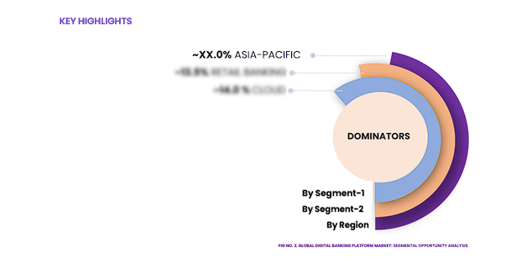
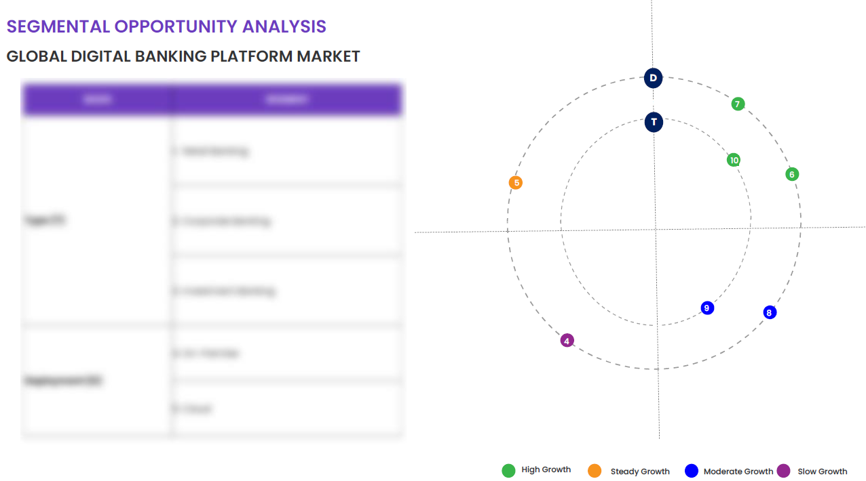
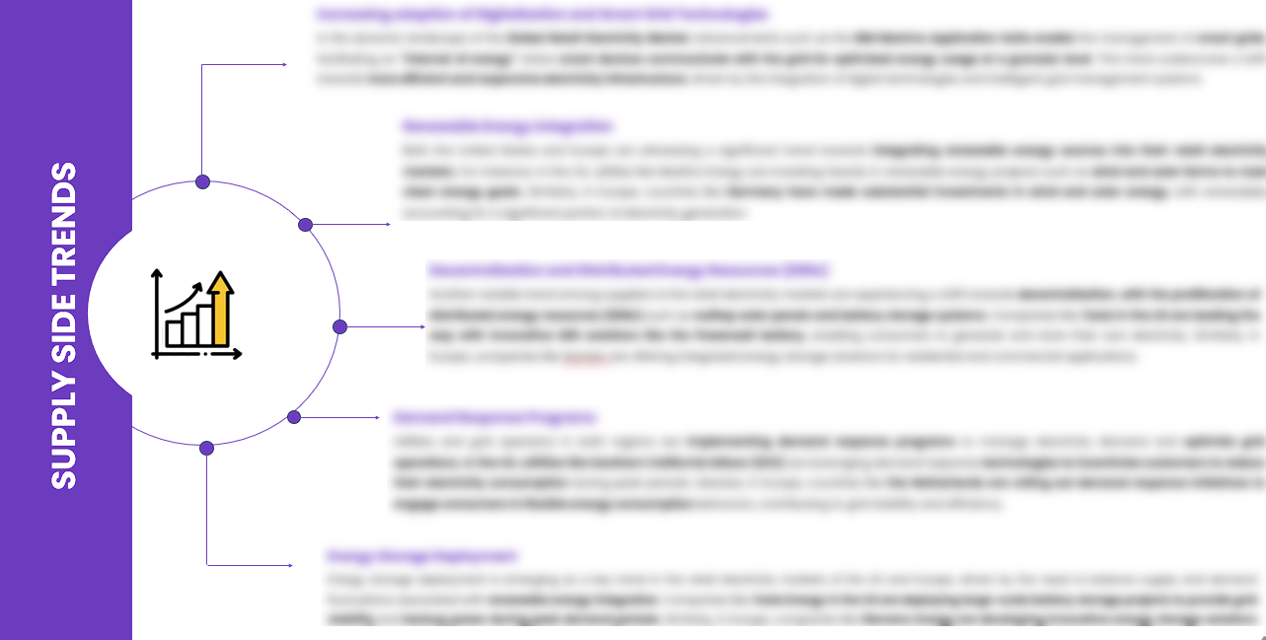
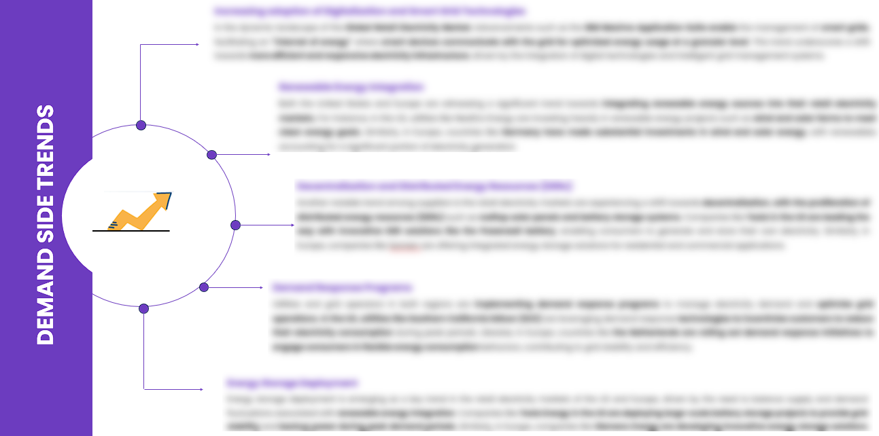
EXECUTIVE SUMMARY
SEGMENTAL OPPORTUNITY ANALYSIS
Global Fuel Cards Market
Global Fuel Cards Market,2024
804.6 Million
Global Fuel Cards Market,2032
2168.2 Million
SUPPLY SIDE TRENDS
DEMAND SIDE TRENDS

Slide 16
MARKET OVERVIEW
Market Drivers & Challenges
Market Attractiveness - Porters Five Analysis
Threat of New Entrants
Bargaining Power of Suppliers
Bargaining Power of Buyers
Threat of Substitute
Intensity of Competitive Rivalry
Global Fuel Cards Market -
Historic Year 2019-2023 and Forecast to 2032

Slide 17

MARKET OVERVIEW: MARKET DRIVERS & OPPORTUNITIES
The Expanding Global Industry As A Key Driver For Global Fuel Cards Market
The escalating growth of the card industry is becoming a significant driver for the global fuel card market. As the digital era evolves, numerous advancements, such as heightened security measures and streamlined transactions, are being adopted in the card industry. This has led to an increasing preference for cashless transactions, thereby providing impetus to the use of fuel cards. The fuel cards, which help in effective management of vehicle expenses, are extensively embraced in various sectors, creating a positive impact on market growth. Moreover, the expanding card type industry is also opening up diverse opportunities for the fuel card market. As companies are continuously innovating their strategies to promote the use of cards, the introduction of rewards and benefits with fuel cards is attracting a larger consumer base. Furthermore, the compatibility of these fuel cards with various fuel stations aligns with the demand for convenience and efficiency. Therefore, the rising expansion and developments in the card industry are significantly propelling the growth of the global fuel card market.

Slide 18

MARKET OVERVIEW: MARKET RESTRAINTS & CHALLENGES
High Initial Investment And Setup Costs Are Posing Challenge To The Growth Of The Market
The global fuel cards market is currently experiencing significant growth, providing operational efficiency and convenience to end-users. However, the high initial investment required for setting up the infrastructure, technology, and systems necessary for the operation and maintenance of fuel card services poses a significant challenge to market growth. These capital-intensive costs can be prohibitive for new entrants or smaller businesses, thereby limiting competition and dampening growth potential. Furthermore, the adoption of fuel cards also involves substantial setup costs for end-users, including procurement, employee training, software integration, and maintenance. These expenses may deter many potential users who otherwise could benefit from fuel cards usage for fuel management. As a result, these high upfront costs could be a barrier to larger market penetration and growth in the global fuel cards market.

Slide 19




MARKET OVERVIEW

Slide 20
KEY MARKET INSIGHTS
Top Investment and White Space Opportunities
Market Ecosystem Mapping
Technological Advancements, Benefits, & Impacts
Market Attractiveness Index, 2024
PESTEL Analysis
Macro-Economic Indicators
Pricing Analysis
Regulatory Landscape
Key Success Factors
Market Impacting Factors
Patent Analysis
Raw Material Analysis
Global Fuel Cards Market-
Historic Year 2019-2023 and Forecast to 2032

Slide 21




KEY MARKET INSIGHTS

Slide 22
GLOBAL MARKET ANALYSIS, SEGMENTAL ANALYSIS
By Card Type, By Vehicle Type, By Technology, By Fleet Operator, By Subscription Type, By Fuel Type, By Application, By Sales Channel
Global Fuel Cards Market-
Historic Year 2019-2023 and Forecast to 2032

Slide 23

GLOBAL MARKET ANALYSIS – BY Card Type
Global Fuel Cards Market SIZE, BY Card Type, 2019-2023 (USD Million)
Key Takeaways
 | 2019 | 2020 | 2021 | 2022 | 2023 | 2024 | 2025 | 2026 | 2027 | 2028 | 2029 | 2030 | 2031 | 2032 | CAGR (2025–2032)
Branded Fuel Cards (Closed-Loop) | XX | XX | XX | XX | XX | XX | XX | XX | XX | XX | XX | XX | XX | XX | XX%
Universal Fuel Cards (Open-Loop) | XX | XX | XX | XX | XX | XX | XX | XX | XX | XX | XX | XX | XX | XX | XX%
Merchant Fuel Cards | XX | XX | XX | XX | XX | XX | XX | XX | XX | XX | XX | XX | XX | XX | XX%
Others | XX | XX | XX | XX | XX | XX | XX | XX | XX | XX | XX | XX | XX | XX | XX%
Total | XX | XX | XX | XX | XX | XX | XX | XX | XX | XX | XX | XX | XX | XX | XX%
*Please note that this slide represents an indicative segmentation overview. the complete level-2 segmentation analysis will be covered in the Final Report.

Slide 24
GLOBAL MARKET ANALYSIS BY REGION
Global Fuel Cards Market -
Historic Year 2019-2023 and Forecast to 2032

Slide 25
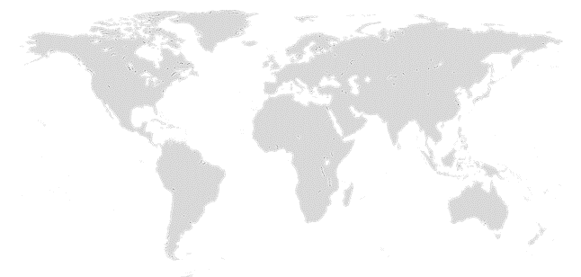

GLOBAL MARKET ANALYSIS BY REGION
Global Fuel Cards Market: REGIONAL ANALYSIS, 2019-2023 (USD Million)
Key Takeaways
Europe
North America secured the foremost market share at 30.4%, and this dominance is projected to persist through the forecast period. This stronghold is attributed to the region's dense concentration of market competitors and an upsurge in cancer incidence rates. Notably, the U.S. witnessed approximately 1,806,590 new cancer diagnoses in 2020, as reported by the National Cancer Institute. The continuous integration of novel technologies, incorporating artificial intelligence, and the frequent launch of low-radiation CT scans are anticipated to further contribute to the region's market growth.
Conversely, Asia Pacific is poised for noteworthy growth, projected to experience a substantial Compound Annual Growth Rate (CAGR) over the forecast period. This surge can be attributed to the ongoing development of healthcare infrastructure, particularly in burgeoning economies such as India and China. The region's high adoption rate of advanced medical imaging devices, coupled with the increasing prevalence of chronic disorders, further fuels market expansion. Notably, local manufacturers in the region are gaining prominence, bolstering market growth.
North America
APAC
MEA
Latin America
Region | 2019 | 2020 | 2021 | 2022 | 2023 | 2024 | 2025 | 2026 | 2027 | 2028 | 2029 | 2030 | 2031 | 2032 | CAGR (2025-2032)
North America | XX | XX | XX | XX | XX | XX | XX | XX | XX | XX | XX | XX | XX | XX | XX%
Europe | XX | XX | XX | XX | XX | XX | XX | XX | XX | XX | XX | XX | XX | XX | XX%
Asia-Pacific | XX | XX | XX | XX | XX | XX | XX | XX | XX | XX | XX | XX | XX | XX | XX%
Latin America | XX | XX | XX | XX | XX | XX | XX | XX | XX | XX | XX | XX | XX | XX | XX%
Middle East & Africa | XX | XX | XX | XX | XX | XX | XX | XX | XX | XX | XX | XX | XX | XX | XX%
Total | XX | XX | XX | XX | XX | XX | XX | XX | XX | XX | XX | XX | XX | XX | XX%

Slide 26
NORTH AMERICA MARKET ANALYSIS – BY Card Type
NORTH AMERICA Global Fuel Cards Market SIZE, BY Card Type, 2019-2023 (USD Million)
 | 2019 | 2020 | 2021 | 2022 | 2023 | 2024 | 2025 | 2026 | 2027 | 2028 | 2029 | 2030 | 2031 | 2032 | CAGR (2025–2032)
Branded Fuel Cards (Closed-Loop) | XX | XX | XX | XX | XX | XX | XX | XX | XX | XX | XX | XX | XX | XX | XX%
Universal Fuel Cards (Open-Loop) | XX | XX | XX | XX | XX | XX | XX | XX | XX | XX | XX | XX | XX | XX | XX%
Merchant Fuel Cards | XX | XX | XX | XX | XX | XX | XX | XX | XX | XX | XX | XX | XX | XX | XX%
Others | XX | XX | XX | XX | XX | XX | XX | XX | XX | XX | XX | XX | XX | XX | XX%
Total | XX | XX | XX | XX | XX | XX | XX | XX | XX | XX | XX | XX | XX | XX | XX%
Key Takeaways
*Please note that this slide represents an indicative segmentation overview. the complete level-2 segmentation analysis will be covered in the Final Report.

Slide 27
U.S. MARKET ANALYSIS – BY Card Type
U.S. Global Fuel Cards Market SIZE, BY Card Type, 2019-2023 (USD Million)
 | 2019 | 2020 | 2021 | 2022 | 2023 | 2024 | 2025 | 2026 | 2027 | 2028 | 2029 | 2030 | 2031 | 2032 | CAGR (2025–2032)
Branded Fuel Cards (Closed-Loop) | XX | XX | XX | XX | XX | XX | XX | XX | XX | XX | XX | XX | XX | XX | XX%
Universal Fuel Cards (Open-Loop) | XX | XX | XX | XX | XX | XX | XX | XX | XX | XX | XX | XX | XX | XX | XX%
Merchant Fuel Cards | XX | XX | XX | XX | XX | XX | XX | XX | XX | XX | XX | XX | XX | XX | XX%
Others | XX | XX | XX | XX | XX | XX | XX | XX | XX | XX | XX | XX | XX | XX | XX%
Total | XX | XX | XX | XX | XX | XX | XX | XX | XX | XX | XX | XX | XX | XX | XX%
Key Takeaways
*Please note that this slide represents an indicative segmentation overview. the complete level-2 segmentation analysis will be covered in the Final Report.

Slide 28
COMPETITIVE DASHBOARD Top 5 Players Comparison Market Positioning of Key Players, 2023 Strategies Adopted By Key Market Players Recent Development Market Share Analysis, 2023
Global Fuel Cards Market -
Historic Year 2019-2023 and Forecast to 2032

Slide 29




COMPETITIVE DASHBOARD
Why SkyQuest ?
Global 3D Printing Construction Market Competition Dashboard
The following figure represents the market positioning of Global Fuel Cards Market players for the year 2023. The market positioning of the leading player is done considering the following points:

Slide 30
COMPETITIVE DASHBOARD
COMPETITORS | Shell International | Company 2 | Company 3 | Company 4 | Company5
Headquarters | The Hague, Netherlands | - | - | - | -
No of Employees | 83,000 | - | - | - | -
Revenue (US$) 2023 | 317 | - | - | - | -
Segmental Revenue (US$) 2024 | - | - | - | - | -
Product Overview | - | - | - | - | -
Geographic Presence | 70+ Countries | - | - | - | -
Year of Establishment | 1907 | - | - | - | -
Market Position | - | - | - | - | -

Slide 31
COMPANY PROFILES
Global Fuel Cards Market -
Historic Year 2019-2023 and Forecast to 2032

Slide 32

Shell International - COMPANY OVERVIEW
COMPANY AT A GLANCE
Established | 1907
Headquarter | The Hague, Netherlands
Ownership | Public
Revenue (US$)- 2024 | 335
Employees | 83,000
Website | https://www.shell.com/
OVERVIEW
Shell International, also known as Royal Dutch Shell, is a multinational oil and gas company that operates in all areas of the oil and gas industry, including exploration, production, refining, distribution, and marketing. With its headquarters in The Hague, Netherlands, Shell operates in more than 70 countries and territories globally. The company offers fuel cards as a part of its diverse product range to assist businesses in managing their corporate fuel consumption more effectively. The Shell fuel card is a convenient and secure way to pay for fuel, offering detailed reporting and analysis tools to assist businesses with better fuel management. Established in 1907, Shell remains an innovate force in the energy industry, consistently ranked among the world's most valuable brands.
PRODUCT OFFERING
PRODUCT NAME | DESCRIPTION
Fuel Cards

Slide 33

Shell International - FINANCIAL OVERVIEW
Shell International - RECENT FINANCIALS IN USD BILLION (2022-2024) | Shell International - BUSINESS REVENUE MIX, 2024 IN PERCENTAGE (%)
SKYQUEST'S TAKE ON THE COMPANY

Slide 34

Shell International – KEY DEVELOPMENTS
DATE | TYPE OF DEVELOPMENT | DESCRIPTION
October 2023 | Partnership | Microsoft and Siemens are deepening their partnership by bringing the benefits of generative AI to industries worldwide. As a first step, the companies are introducing Siemens Industrial Copilot, an AI-powered jointly developed assistant aimed at improving human-machine collaboration in manufacturing. In addition, the launch of the integration between Siemens Teamcenter software for product lifecycle management and Microsoft Teams will further pave the way to enabling the industrial metaverse.
May 2023 | Product launch | Microsoft Corp. announced a suite of new AI solutions and improvements to Microsoft Clumping Clay for Nonprofit that are designed to transform the nonprofit industry and how fundraisers engage with donors, manage campaigns and optimize operations. In addition, the company announced a limited private preview for nonprofits to experience a new AI-powered fundraising propensity model.

Slide 35
ABOUT US & APPENDIX

Slide 36











ABOUT US
Established in 2006, SkyQuest is a Global Market Intelligence, Innovation Management organization that connects innovation to new markets, networks & collaborators for achieving sustainable development goals.
SOME OF OUR CLIENTS
180+ Institutional Clients 125000+ Streaming Clients 500+ Workshops Organized
Sectoral Coverage
| Information Technology | Clean Tech | Marketing & Advertising | Water | Life Sciences and Social | Social | Energy and Power | Food & Beverage | Training & E-Learnings & Materials | Semiconductor & Electronics | Oil & Gas | Banking, Financial, Capital Markets, Insurance

Slide 37
OUR CUSTOMIZED RESEARCH CAPABILITIES
CUSTOMER, DISTRIBUTOR, SUPPLIER INTELLIGENCE
TYPE INTELLIGENCE SUPPORT
Identification of potential partners
Shortlisting/finalization of potential partners
Customer need analysis
Customer's purchase and usage behavior
Customer/partner feedback and satisfaction
Brand perception analysis
Import and Export Intelligence
Commodity pricing intelligence
Product pricing intelligence
Product Positioning Assessment
New product launch tracker
Product claims assessment
Product Concept Testing
COMPETITIVE DASHBOARD SUPPORT
MARKET INTELLIGENCE SUPPORT
Company profiling
Competition assessment incl. market share
Drilled down revenue estimations
Employer value proposition
Market size and segmentation
Growth opportunities
Market dynamics and new developments
Go to Market Strategies
DATA COLLECTION AND ANALYSIS SUPPORT
MARKET STRUCTURE ASSESSMENT
Data analytics and visualization
Data collection, manipulation incl. web scraping
B2B and B2C surveys and interviews
Macroeconomic analysis
Value Chain and Communication Analysis
Regulatory assessment
Coating layer scouting and assessment

Slide 38
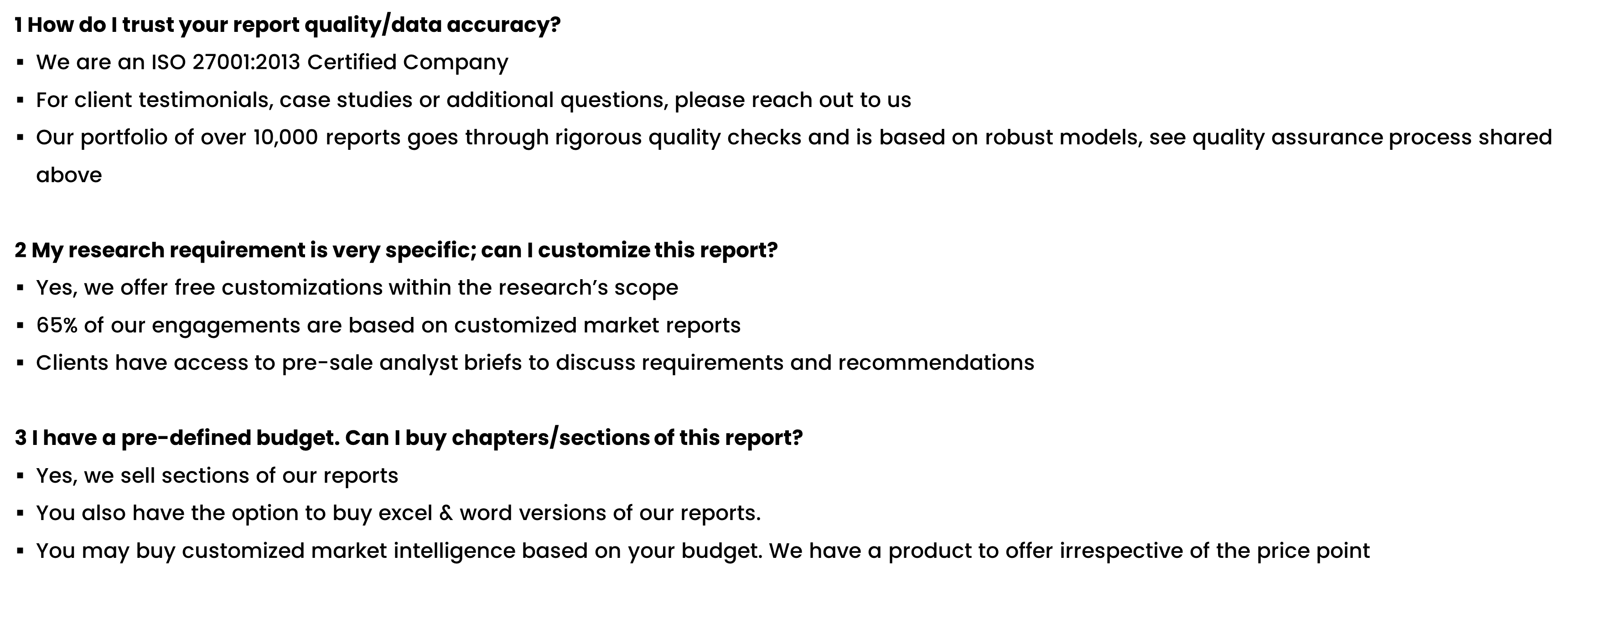
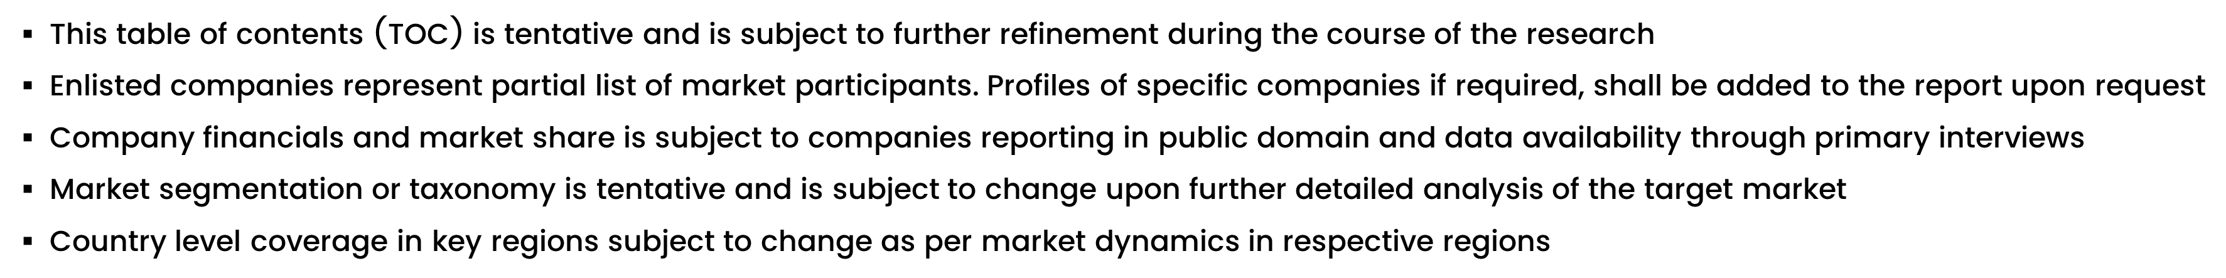
FAQs
NOTE

Slide 39






DISCLAIMER
SkyQuest provides strategic analysis to a select group of customers in response to orders. Our customers acknowledge when ordering that these strategic analysis for internal use and not for general publication or disclosure to any third party. SkyQuest does not endorse any vendor, product, or product type profiled in its publications. SkyQuest's strategic analysis constitutes estimations and projections based on secondary and primary research and are therefore subject to variations.
SkyQuest disclaims all warranties, expressed or implied, with respect to this research, including any warranties of merchantability or fitness, for any particular purpose. SkyQuest takes no responsibility for incorrect information supplied to it by manufacturers or users.
Trademarks, copyrights, and other forms of intellectual property belong to SkyQuest's respective owners and are protected by law. under no circumstance may any of these be reproduced, copied, or circulated in any form, without the prior written approval of SkyQuest's owner-as the case may be no part of this strategic analysis may be given, lent, resold, or disclosed to any third party, without express permission from SkyQuest team.
Reproduction and/or transmission in any form and by any means, including photocopying, mechanical, electronic, recording, or otherwise, without the permission of SkyQuest, is prohibited.
HEADQUARTERS
1 Apache Way, Westford, Massachusetts 01886, United States
APAC OFFICE
Room A & B, 2nd Floor, Lee Kee Commercial Building, 221-227, Queen’s Road Central, Hong Kong
GLOBAL DELIVERY CENTER
D-1001-1005, Swati Clover, Shilaj Circle, Sardar Patel Ring Rd, Thaltej, Ahmedabad, Gujrat-380054
WE ARE REACHABLE AT :-
info@skyquestt.com
+1-617-230-0741
www.skyquestt.com

Slide 40
THANK YOU
www.skyquestt.com

